Slide 1

With the name of Allah, Who is the most Gracious and Merciful

Slide 2
Big Theta (Θ) Notation
Big Theta (Θ) notation is a mathematical notation used in computer science to describe the asymptotic behavior of functions.
It characterizes the tight bounds on the growth rate of a function in both the upper and lower directions.
.

Slide 3
In simpler terms, when we f(n)=Θ(g(n)), it means that there exist positive constants c1​,c2​, and n0​ such that for all n≥n0​, the function f(n) lies between c1​⋅g(n) and c2​⋅g(n) inclusive.

Slide 4
Big O Notation (O):
0 ≤ f(n) ≤ c2.g(n) ∀ n ≥ n₀
Big Omega notation
○ < c1. g(n) < = f(n) for all n >= no

Slide 5

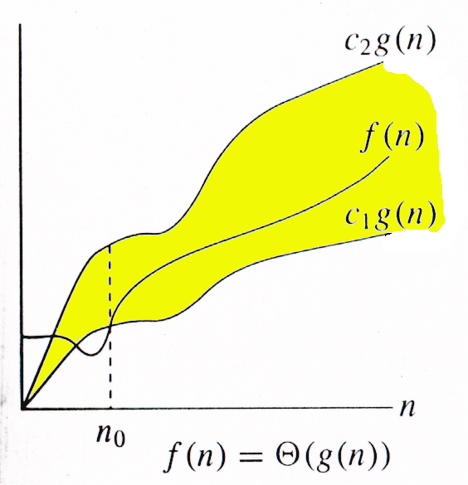
Theta Notation
f(n) ∈ Θ(g(n))
Wajahat Akbar Advanced Algorithms Analysis and Design

Slide 6
Suppose we have two functions, f(n)=2n and g(n)=n. We want to determine whether f(n)=Θ(g(n)).
To show this, we need to find positive constants c1​, c2​, and n0​ such that 0≤c1​⋅g(n)≤ f(n)≤ c2​⋅g(n) for all n≥n0​.
Let's find these constants:
c1​=1: This is the lower bound constant.
c2​=3: This is the upper bound constant.
n0​=1: The threshold value from which the bounds hold.

Slide 7
Therefore, we can conclude that f(n)=Θ(g(n)) with c1​=1, c2​=3, and n0​=1. This means that g(n) provides a tight asymptotic bound on f(n) as n becomes large. In mathematical notation, we express this as f(n)=Θ(n).
Examples
Now, let's check the conditions:
For the lower bound: 1⋅n≤2n
For the upper bound: 2n≤3⋅n
These conditions hold true for all n≥1.
Advanced Algorithms Analysis and Design

Slide 8
Thank You

